Slide 1
Sex Offenders with Intellectual and Developmental Disabilities(I/DD): Barriers and Solutions from Around the Nation
The Arc’s National Center on Criminal Justice and Disability™ (NCCJD)
Leigh Ann Davis, M.S.S.W., M.P.A., Program Manager
Kathryn J. Walker, J.D., M.P.H., Criminal Justice Fellow

Slide 2
Welcome!
First time using webex?
You can communicate using the Chat Box and seek technical assistance if needed.
You can type questions about the material presented in the Q&A section.
Use this link for live captioning: http://streamtext.net/text.aspx?event=Arc
Today’s webinar will be recorded and archived on the NCCJD website. Please keep this in mind when sharing information and experiences during the webinar.

Slide 3
Introduction
Leigh Ann Davis, M.S.S.W., M.P.A., Program Manager
Kathryn Walker, J.D., M.P.H., Criminal Justice Fellow

Slide 4
Thank you to all our presenters
Blake, Self-Advocate, and Brian, Family Advocate
Carol, Family Advocate, and Adam
Jessica Oppenheim, Esq., Director of The Arc of New Jersey’s Criminal Justice Advocacy Program
Randy Shively, Ph.D., Alvis House, Columbus, Ohio
Dr. Elise Magnuson, Psy.D., LCSW
Marc Goldman, MS, LPA
Colleen Mercuri-Johnson, MSW, LISW-S, Butler County Board of Developmental Disabilities, Hamilton, Ohio
Chris Snell, Director of the TREE program at CLASS
Elizabeth Kelley, Attorney at Law, National Association of Criminal Defense Lawyers Board Member

Slide 5
Disability Basics:
Understand: Know the challenges people with disabilities face
Understand: Knowing one person with a disability means you know ONE PERSON with a disability
Understand: This is a human rights issue just like race, gender, and religion

Slide 6
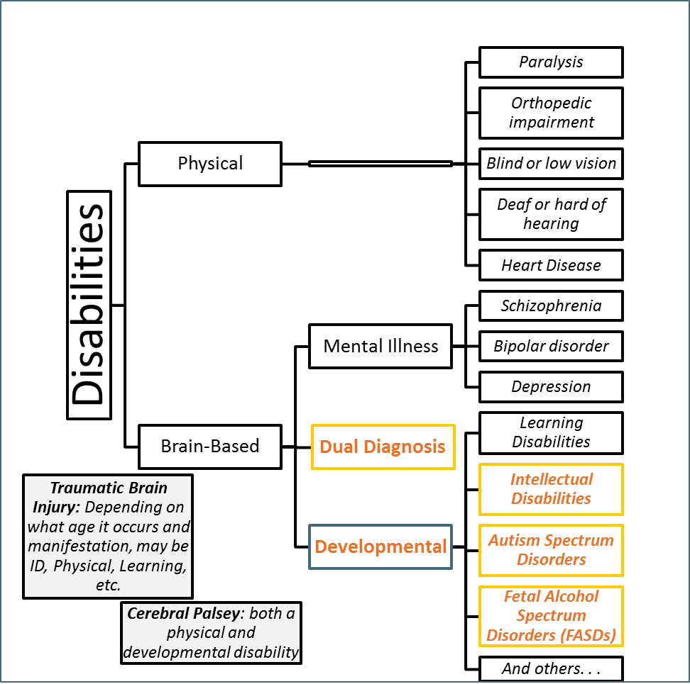
Notes:
This is not an exclusive list of disabilities but is a way to help visualize the wide array of experiences that "disability" can indicate. The words in italics are examples of some of the types of disabilities you may encounter. There are definite limitations to the chart, for example TBI and CP can fall under multiple categories.
EXE: Someone with a traumatic brain injury (TBI) may have physical issues, intellectual issues, or mental illness as a result of their injury.
EXE: Cerebral Palsy (CP) will have a physical disability component but may or may not be accompanied by intellectual disability.
While the diagnoses in the diagram are necessary in the legal system for many reasons, in exigent (or emergency) circumstances, it may be most efficient to examine functional needs of the person you are working with. Functional descriptions of disabilities describe the skills a person has or lacks and identifies what they enable the person to do. These functional descriptions allow professionals to identify the specific skills that a person needs to acquire to meet certain goals and the supports needed to gain those skills.

Slide 7
Points to Remember
These are hard issues to discuss, and are rarely as clear-cut as we would like
People with disabilities should take responsibility for their actions; likewise society should acknowledge true risk
You don’t have to reinvent the wheel around these issues—there are seasoned professionals doing great work.

Slide 8
Stories from the System
Blake

Slide 9
How this has affected Blake
Bullying, people check the internet and harass me.
Treated as an outcast
Fear of the police, fear of going back to jail for any minor issue
Don’t trust anybody,
Fear of driving in that town where the incident occurred
Limited where I can live
Housing opportunities - discriminated/not allowed
Unable to live in disability support housing.
Post-traumatic stress disorder (PTSD) triggered by this terrifying event
Depression, flashbacks, nightmares,
Severe anxiety and uncontrollable thoughts about the event
Sense of hopelessness
This happens weekly. Can not purse my hopes of a career in psychology and very few other options
A scared of meeting new people feeling like they already have a judgment
Limited in where I can go.
I can’t even travel to see my grandmothers in Florida.
I have to check in and out of each state every time I go back and forth to school.

Slide 10
How it has affected our family
Caused depression.
Mistrust of judicial process. How could our justice system be so inhuman. No second chance at life
Even the medical experts involved with the case could not believe it went this far. How can this be fair and just, when drug dealers and terrorist do far worse and are not marked for life. Yet one incident he, our family and his future family are marked for life
People have harassed my wife at work; stress in the family
People have harassed my younger son.
Because of this, he is limited in the services he is entitled to as part of his disabilities, particularly group homes, or housing.
Unemployment is 10 -15% higher for people with disability, let alone being on the registry.
practically impossible for him to have any type of life and career. His
What happens to him after we are gone.
If he is pulled over for even a broken taillight, he could be taken off to jail.
He needs help in understanding all of the restrictions of being on the list with his disability. One mistake would put him in jail immediately, even a clerical error. We or some one from his autism program must go with him when he registers. It causes trauma, depression and withdrawal every time he has to register.
The alleged victim continues to taunt him every year on the anniversary of the event.
Financially it has cost all of our savings
It has been total devastation to our entire family every day of our lives. There is always something that happens, whether it is something someone sees on the internet , or where we are going that day.
It has been a living nightmare everyday of our lives and fear of what could happen to him.

Slide 11
Stories from the System
Adam

Slide 12
Sex offender registration and community notification laws
Jessica Oppenheim, Esq., Director of The Arc of New Jersey’s Criminal Justice Advocacy Program

Slide 13
Criminal Conviction/Juvenile Adjudication
Diagnosis of a developmental disability is not a bar to criminal charges as a juvenile or adult
In every State, a conviction for a sex offense now carries with it the obligation to register as an offender and be subject to some level of community notification
Notes:
States vary as to whether they also require registration by juvenile offenders who have been adjudicated delinquent. Under the federal Sex Offender Registration and Notification Act (SORNA) there is a minimum standard that jurisdictions register juveniles who were at least 14 years of age at the time of their offense and used force or drugs to accomplish the assault. To date, 19 States have adopted SORNA-compliant statutes. For a full review of all States’ juvenile registry information, see A Snapshot of Juvenile Registration and Notification Laws: A Survey of the United States (2011).

Slide 14
Obligations Created
Registration for conviction, adjudication or not guilty by reason of insanity by filling out a Form on a regular basis
Community Notification of registrant’s home address, place of employment, and place of schooling, in some cases with information included on an internet website

Slide 15
Registration Statutes
The intent of the statute is to provide reliable information about the whereabouts of criminal offenders who have been convicted of an enumerated sex offense
The goal of the statute is to allow the State the ability to supervise and oversee offenders even after they have been released into the community
Notes:
Research does show that more reliable information about sex offense convictions and offenders is available. No research supports a finding that this results in reduced recidivism

Slide 16
Consequences
Housing Options
Access to Public Housing is limited by the requirement to register
Offenders sentenced to some form of parole or community supervision for life may have conditions placed on them which bar them from living in households with minor children
Some States have statutes which bar offenders from living within proximity of schools
Supported housing providers can be uncomfortable serving this population

Slide 17
Consequences
Job Opportunities
Supported job options and rehabilitation services may limit registered sex offenders from accessing services
Parole officers supervising offenders can impose conditions on work choices
Background checks—more than 90% of companies perform background checks

Slide 18
Consequences
Increased Anxiety
Individuals with I/DD must comply with conditions and obligations and may find it challenging to maintain compliance independently
New Charges
Failure to comply can result in new criminal charges and new prison sentences

Slide 19
Risk Assessment: Effective Model for DD Individuals with Sexual Issues
Randy Shively, Ph.D., Alvis House, Columbus, Ohio

Slide 20
Proportionally More Sex Offenses
Higher proportion of sex offenses with DD offender population when compared to the non-DD offender population
Why? Why? Why?

Slide 21
Why more sex offenses?
Fewer dating opportunities
Belief in ID world that those with cognitive delays are asexual
Less tolerance of sexual deviance in community
Poor social skills-poor decision making

Slide 22
Million Dollar Question
Is the DD client’s sex offending due to true deviance or due to a lack of understanding of his sexuality and environment or both?
Paraphilias may be grossly overestimated- keys are arousal and fantasy

Slide 23
Risk Assessment with the ID
Risk can never be accurately predicted but it can be effectively managed
External factors affect risk: need for staff supervision, quality of staff supervising, specific triggers for client in the environment, structure of schedule

Slide 24
Risk Assessment with ID
Internal Factors affect risk: physical condition, stability from mental health medications, daily mood, diet, thinking errors and feeling about staff and current environment
True mistakes can be made with this population when inappropriate sexual behavior is automatically assumed to be deviant

Slide 25
Promising Instruments
Phenix and Sreenivasan (2009) list of DD specific risk factors:
Social skills deficits; Committing violent offenses; being unemployed; psychiatric history; substance use disorder; easily susceptible to the influence of others; history of delinquency; poor response to treatment; antisocial attitude; low self-esteem; impulsivity to sexual acting out; high static risk

Slide 26
Promising Instruments
Socio-sexual Knowledge and Attitudes Assessment Tool-Revised (Griffiths and Lunsky)
Identifies with concrete pictures the understanding and preferences in the areas of : Anatomy, Men’s and Women’s Bodies, Intimacy, Pregnancy, Birth Control, Healthy Boundaries

Slide 27
Promising Instruments
Assessment of Risk and Manageability of Individuals with Developmental and Intellectual Limitations who Sexually Offend (ARMIDILO-S) Boer et al, 2012
Stable items: supervision compliance, treatment compliance, sexual deviance, sexual preoccupations, emotional coping, relationships, impulsivity, substance abuse, mental health

Slide 28
ARMIDILLO-R: Acute
Acute items: changes in client’s compliance with supervision and treatment; changes in sexual preoccupation, changes in victim-related behaviors, changes in emotional coping, changes in the use of coping strategies, changes in monitoring, changes in social relationships, situational changes, changes in victim access

Slide 29
Model for ID Risk Assessment
Assess Intellectual Delays related to risk
Assess Mental Health problems related to risk
Assess offending behaviors/history

Slide 30
Model for ID Risk Assessment- Intelligence
Intelligence Level: do they understand right from wrong? Do they understand consent? Do they understand what consequences are connected to their behaviors? Can they pick out important cues in their environment linked to pro-social behaviors? Do they have an adequate immediate or short-term memory? Are they slow at processing new information? Do they have a developmental disability?

Slide 31
Intelligence: Key Question
Does their cognitive delays help explain some of the bad decisions related to their offending behaviors?
What concrete learning strategies might help manage risk of offending?

Slide 32
Model for ID Risk Assessment- Mental Health
Mental Health Issues: what is the working diagnosis? Which diagnoses are not currently accurate? What is the client’s current mental status? Is the client stable on their medications? Are they compliant in taking their medications? Can they self medicate? Do they need supervision taking their medications? Is the team working well with their psychiatrist? Do they understand their own diagnoses?

Slide 33
Key Questions: Mental Health
How does the client’s current mental health symptoms impact managing the client’s risk?
What can be done to stabilize client’s negative symptoms?
Were any delusions or hallucinations associated with offending behaviors?

Slide 34
Offender Risk History
Has this client had official charges or behaviors which could have been prosecuted?
Is this client motivated to stay out of trouble or do they have an antisocial attitude?
What triggers the client’s behaviors and are they successfully managing triggers?

Slide 35
Offender Risk History
Are they fully aware of the consequences of their behaviors?
How much disclosure do they have about the behaviors which have been documented?
What types of thinking errors do they use when they discuss their offenses?

Slide 36
Offender Risk History
Any history of violence?
Violence used in offense(s)
Family role models- history related to client
How does current Behavior Support Plan address risk? What is in Individual Support Plan?

Slide 37
Staff Issues
Be very aware of the possibility what you are told is only part or none of the truth= investigate
Do not argue with SO – they often use anger to try and control the situation
Separate the sexual behavior from the person= only attack behaviors, not the person

Slide 38
Staff Issues
Realize many of the SO clients do not know who they are- they struggle with an identity separate from their offense
Communication with other staff is vital for the success of the program- the SO goal is to split staff

Slide 39
Effective Staff Attributes
Be consistent
Be professional
Be firm and fair
Be a resource

Slide 40
Staff have tremendous power in our interactions with our clients
“I’ve come to the frightening conclusion that I am the decisive element in the consumer’s life. It’s my personal approach that creates the climate; it’s my daily mood that makes the weather. I possess a tremendous power to make a consumer’s life miserable or joyous. I can be a tool of torture or an instrument of inspiration; I can humiliate or humor, hurt or heal. In all situations, it is my response that decides whether a crisis will be escalated or deescalated and a consumer humanized or dehumanized”
Ginott, 1993

Slide 41
Contact
Randy Shively, Ph.D.- Alvis House- 2100 Stella Ct., Columbus, 43215, 614-252-8402
randy.shively@alvishouse.org

Slide 42
References
Ashford, J., Sales, B., and Reid, W. 2001. Treating adult and juvenile offenders with special needs. American Psychological Association: Washington, DC.
Lindsay, W. 2009. The treatment of sex offenders with developmental disabilities: A practice workbook. Wiley-Blackwell: Malden, MA.
Lindsay, W., Taylor, J., and Sturmey, P. 2004. Offenders with developmental disabilities. John Wiley and Sons, Ltd.: West Sussex, England.
National Association for the Dually Diagnosed. 2007. Diagnostic manual- intellectual disability: A clinical guide for the diagnosis of mental disorders in persons with intellectual disability. Kingston, NY.
Seligman, L. 1998. Selecting effective treatments: A comprehensive guide to treating mental disorders. Jossey-Bass, Inc.: San Francisco, CA.
Quinsey, V., Harris, G., Rice, M., and Cormier, C. 1998. Violent offenders: Appraising and managing risk. American Psychological Association: Washington, DC.
Center for Sex Offender Management. 2000. Myths and facts about sex offenders. (csom.org/pubs/mythsfacts)
Harris, J., and Hanson, RK. 2004. Sex offender recidivism: A simple question. Public Safety and Emergency Preparedness: Canada.(www.psepc-sppcc.gc.ca)
Finkelhor, D and Jones, L. 2004. Explanation for the decline in child sex abuse cases. Office of Juvenile and Delinquency Prevention. (ncjrs.gov/pdffiles1)
Bureau of Justice Statistics. 2001. Data collection national crime victimization survey. (bjs.gov/index)
Heil, P., Ahlmeyer, S., and Simons, D. 2003. Crossover sexual offenses. A Journal of Research and Treatment, vol 15(4).
US Dept of Justice. Full report of the prevalence, incidence and consequences of violence against women. (ojp.usdoj.gov/nij).
Dornin, C. 2010. Facts and fiction about sex offenders. University of Cincinnati. (corrections.com/news/article/24500-facts-and-fiction-about-sex-offenders).

Slide 43
Psychosexual Assessments
Elise C. Magnuson, Psy.D., LCSW

Slide 44
Psychosexuals – What are they?
An evaluation of a person who is charged with a sex offense or has committed one.
Inform teams and legal decision makers
Used to develop risk management plans

Slide 45
Psychosexuals – what they are not
Able to tell if someone committed a sex offense
If someone will commit a sex offense
NOBODY CAN TELL THE FUTURE

Slide 46
Psychosexuals – Assessment of Risk
Compare one person to a group of other people
Actuarial
Static-99
Structured Clinical Judgments
Armadillo – takes into account the support team around the person, designed specifically for people with an intellectual disability

Slide 47
Psychosexuals --
Risks
Benefits
Over or underestimating the impact of an intellectual disability
Over or underestimating risk
Blaming people rather than understanding what is
Clear understanding of the person
Help teams develop plans for supporting the person
Provide information to decision makers

Slide 48
Risk Factors
The factors that are risks for people to reoffend are the same, regardless if they have an intellectual disability
Don’t discount the risk because it’s not their fault
Don’t discount the importance of the environment in managing risk.

Slide 49
Treatment Planning
Make sure it’s tailored to the person.
Needs to take into account cognitive functioning.
Make sure to use supports that are in place or get more supports as needed.

Slide 50
Tips for Teams
Don’t over or underestimate risk.
Communication among team members is critical.
Everyone needs to be informed about the risk and any plans for supporting the person.
Consistency in the message to the person

Slide 51
Community Safety Planning
Marc Goldman, MS, LPA
goldmarc@prodigy.net

Slide 52
Assessment Based Safety and Intervention Plan
Control social and environmental risk factors
Access to potential victims
Access to high risk settings
Access to destabilizers
Level of supervision
Proactive Interventions
Interventions designed to reduce/eliminate dynamic internal factors; teach adaptive behaviors

Slide 53
Assessment Based Safety and Intervention Plan
Establish crisis indicators
Interventions for when crisis indicators are observed
Established clear system response to undesirable behavior and inform the individual

Slide 54
Dynamic Variables That Appear Significant
Victim access
Anger/hostility v Emotional control
Poor; self care/personal hygiene/domestic activity
Responsibility/impulsivity
Positive coping skills
Insulting, teasing, obnoxious verbal behavior
Compliance with; supervision, treatment
Cognitive distortions
Lack of consideration for others
Substance abuse

Slide 55
Developing Sex Offender Protocols: One State’s Process
Colleen Mercuri-Johnson, MSW, LISW-S, Butler Co. Board of Developmental Disabilities, Hamilton, Ohio

Slide 56
Work Group Members
Department of Developmental Disabilities
hio
Partner Organizations Colleen Mercuri Johnson MSW, LISW-S Director of Problematic Sexual Behavior Team-Counselor Butler County Board of Developmental Disabilities
Drew Williams Director of Service and Support Administration County of Summit Developmental Disabilities Board
Janet Keeler Ph.D. Forensic Liaison and Behavioral Support Services Supervisor Cuyahoga County Board of Developmental Disabilities
Gina Kerman Director of QA Compliance Phoenix Residential
Buffie LaBelle Regional Director The Mentor Network
Patricia Hill Director of Staff Development and Video Conferencing Alvis House
Zachary Haughawout Deputy Director Communications and Legislative Affairs Heidi Hughes Clinical Services Supervisor Columbus Developmental Center
Vicki Jenkins Associate General Counsel
Connie McLaughlin Regional Manager Supervisor MUI Registry Unit
Scott Phillips Assistant Deputy Director MUI Registry Unit
Notes:
Text from slide 4:
Workgroup members selected because of their experience in serving individuals with developmental disabilities who have convictions for sex offenses

Slide 57
Assessed areas of need
Tools developed for -The individual -Their SSA -Their providers
-Members of their team
Workgroup Focus
Sex Offender Protocol
Checklist Guide
Environmental Assessment
Considerations for Relapse Prevention
Notes:
Considerations for developing a Relapse Prevention Plan

Slide 58
Basic Assumptions
People have their unique histories and understanding which led to their offense behavior.
Not a “one size fits all” approach
Increased risk means increased scrutiny.
Risks can be mitigated in a community-based setting.

Slide 59
Purpose of the Protocol
Better understand the individual.
Develop better service plans for the individual.
Based on the outcome/recommendations of the assessment
Include treatment and supervision needs
Encourage collaborations
probation/parole officer
CBDD and provider agencies
treatment provider
guardian, natural supports, etc.

Slide 60
Guidelines for Assessment
Sex offender specific assessment
Qualifications of assessor:
Hold advanced degree in a mental health discipline
Hold an independent license or are being supervised by an independently licensed person
experience in evaluating sexual/violent risk in persons with I/DD

Slide 61
Preparing for the assessment
Encourage CBDD to have a list of local assessors on hand
Gather collateral information a head of time
Residential hx
Social/medical/treatment hx
Psychological evaluations
Current ISP/staffing ratio/ Behavior Support Plan
Hx of legal involvement
Factor in time of day when scheduling
Are the better times for the individual to engage

Slide 62
Preparing cont.
Communicate w/ assessor before assessment
Discuss how recommendations will be utilized in plan development
staffing/supervision
residential/day program
vocational choices
media, etc.

Slide 63
Service Plan Development
Individual is included in the development
Collaborative effort in developing and monitoring plan is strongly suggested.
Use of structured reasoning based on recommendations from the assessment.
Reviewed frequently and updated as needed.
Fading of restrictions should be slow and with consensus of the support team.

Slide 64
Consideration for plan development
Individual’s level of cooperation with services/supports.
Individual’s capacity for independent living.
Individual’s legal status e.g. reporting status, probation/parole requirements, etc..
Impact of MH and/or IDD on ability for decision making.
Degree of assessed risk associated with environment and activity.
Implications of rights restrictions on the individual’s rights.
Disclosure: high risk environments lend to more detailed disclosure vs. low risk environments.

Slide 65
Supervision Guided by Assessment
Does it comply with court orders?
Intensity may vary with environment depending on protective and risk factors within each.
Protective = factors which decrease opportunity for re-offense
Risk = factors with increase opportunity for re-offense
Both are unique to the person
Look to fade intensity over time as person progresses in treatment and/or demonstrates self management

Slide 66
Relapse Prevention Plans (see doc Considerations for Developing Relapse Prevention Plans. . .)
Written with and for the person
Strategies/skills for their use
Person chooses best fit
Suggestions may come from others
Use clear/direct wording/pictures if helpful.
Staff have knowledge of RP and support when needed
Based on the person’s unique offending traits.
Utilize assessment
Treatment provider (have more info regarding specifics)
Review often, adjust as needed

Slide 67
Example from Tx plan
Primary Goals: “stay out of jail/prison”, “work on my anger”, “feel good” ”have a girlfriend” “get a job”
Strengths: “I’m funny”, “people like me”, “I have my mom”, “I’m good at work”
Things that get in my way: “My past [criminal]” “sometimes can’t control myself” “I say things that people get mad at”

Slide 68
Challenge: The right to decline services
Use community control via reporting requirements, probation/parole, local police, courts understanding of IDD supports, etc..
Mandate compliance with notice/reporting requirements
Maximize treatment compliance
Focus on skill development

Slide 69
Thank You for Listening in
cmercuri@butlerdd.org

Slide 70
Specialized Employment Services (SES): Employment program treatment modality and community collaborations identifying and addressing issues within criminal justice and first responder issues
Chris Snell, Director of the TREE program at CLASS

Slide 71
The TREE program at CLASS: Employment program treatment modality and community collaborations identifying /addressing issues within criminal justice and first responder issues

Slide 72
Tree Program Overview
Environmental setting includes 7 “homebases” that are rooms containing clusters of individuals.
Each homebase is populated based on specific needs, supervision, compatibility, and vocational skills.
These homebases are re-clustered at least twice annually to transition individuals to more appropriate areas dependent on their successes and challenges over the previous six months.

Slide 73
Tree Program Best Practices: Core Components Assessment Treatment Therapeutic Work

Slide 74
Tree Program Information and Links
http://www.classinc.org/TREE-webinar-landing-page.html
Sign up if you are interested in joining our mailing list and password-protected members page, where we provide in-depth information on the population we support and the service delivery strategies we employ.
For more information contact Chris Snell at csnell@classinc.org

Slide 75
REPRESENTING PEOPLE WITH MENTAL ILLNESS AND INTELLECTUAL/DEVELOPMENTAL DISABILITIES
Elizabeth Kelley, Criminal Defense Attorney

Slide 76
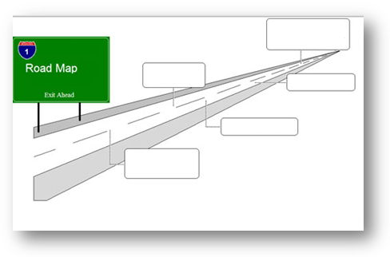
Mitigation
If requesting an intermediate sanction, have a plan.

Slide 77
Questions?
Register here for the next webinar on September 30th, Justice Involved Youth with I/DD
Sign up to receive email alerts, use I&R/TA service, and refer others
Download the paper Sex Offenders with Intellectual/Developmental Disabilities: A Call to Action for Criminal Justice Professionals at www.thearc.org/NCCJD
Contact us at:
NCCJDinfo@thearc.org

