Slide 1
People with Disabilities in the Criminal Justice System: Promising Legislation for Statewide Reforms
February 25, 2016 1:30-3:00 pm EST
The Arc’s National Center on
Criminal Justice and Disability® (NCCJD)
Notes:
Welcome
Introduce myself and LAD

Slide 2
Welcome to NCCJD’s Webinar
First time using webex?
You can communicate using the Chat Box and seek technical assistance if needed.
You can type questions about the material presented in the Q&A section.
Use this link for live captioning: http://streamtext.net/text.aspx?event=Arc
Today’s webinar will be recorded and archived on the NCCJD website. Please keep this in mind when sharing information and experiences during the webinar.

Slide 3
Introduction
The Arc’s National Center on
Criminal Justice and Disability®
Leigh Ann Davis, M.S.S.W., M.P.A., Program Manager
Ashley Brompton, J.D., Criminal Justice Fellow

Slide 4
Thank you to our presenters
Heather Sachs, VP of Advocacy and Public Policy, National Down Syndrome Society (NDSS)
Patti Saylor, Owner, Health Link LLC and Parent Advocate
Darla Stuart, Executive Director, The Arc of Aurora
Diana Goldberg, Executive Director, Sungate Kids
Carole O’Shea, Supervisor Victim Advocate, Aurora Police Department
Maggie Conboy, Chief Deputy District Attorney, Denver District Attorney’s Office

Slide 5
Huffington Post Blog
“America must turn the page on its over-dependence on the criminal justice system. In order to break arrest cycles and end inappropriate criminalization of people with mental illness, we must support community based behavioral health care. We need...systems dedicated to recovery for adults, resiliency for children and self-determination for people with intellectual disabilities. It is a new year, a time for reflection and new resolve. America needs a new approach to mental health care - it is a matter of life and death” “In case of mental health emergency, call a Mobile Crisis Team” by Ginger Lerner-Wren. Huffington Post Blog. Dec 30, 2015.
Notes:
A recent Huffington Post article stated: "America must turn the page on its over-dependence on the criminal justice system. In order to break arrest cycles and end inappropriate criminalization of people with mental illness, we must support community based behavioral health care. We need...systems dedicated to recovery for adults, resiliency for children and self-determination for people with intellectual disabilities. It is a new year, a time for reflection and new resolve. America needs a new approach to mental health care - it is a matter of life and death."
It’s becoming increasingly apparent just how often people with intellectual and developmental disabilities (I/DD) are suffering at the hands of a criminal justice system that struggles to either identify their disability or know how to respond to them as either victims, suspects or offenders. For example, the popular Netflix documentary “Making A Murderer” showcasing Brendan Dassey’s coerced confession provided a view into a different side of the criminal justice system some have never seen before, and people with little or no direct involvement in disability and justice issues are witnessing how hard it can be for suspects with I/DD to experience a fair system of justice.
Bob Dillon wrote the hit song “The Times, They Are a-Changin” in the mid-60’s as a deliberate attempt to create an anthem of change for his time. Thankfully, criminal justice reform is in the air, as evidenced by the President’s Task force on 21st Century Policing, which addresses “mental health” issues. There are bipartisan coalitions working together to achieve some level of success in reducing mass incarceration through sentencing reform and other measures. President Obama also emphasized criminal justice reform in his State of the Union address. But the question remains, will people with intellectual and developmental disabilities – many of whom make up a majority of people in the criminal justice system – be left out? Even if “the times are a-changin” with regard to criminal justice reform, how will people with disabilities be included in this conversation, or will they even be invited to the table? When the President’s report mentions “mental health”, does that include people with I/DD too? If we are to effectively change our criminal justice system, how will we meaningfully take into account people with I/DD who are overrepresented in the system (both as victims and suspects), and at the same time, often invisible as well? NCCJD is researching this issue, diving deep into these difficult questions and seeking achievable solutions. We are on the front-lines actively working to support policies that will:
Support quality education and training for law enforcement, prosecutors and public defenders so that individuals with I/DD are identified and provided services/accommodations throughout their experience in the criminal justice system, and have opportunities for pre-trial diversion
· Ensure individuals with I/DD have access to sentencing reduction programs, along with accommodations and support
· Enable the criminal justice system to better identify individuals who have I/DD in all stages of the criminal justice system, whether the individual is a victim or suspect/offender
NCCJD’s mission is to bridge the gap between the criminal justice and disability worlds. Over the next two years, with the support of DOJ’s Bureau of Justice Assistance, we will be addressing timely issues like competency to stand trial, and the intersection of race and disability in policing in white papers, infographics, and other publications. We are expanding our Pathways to Justice™ training program to include an elective module for Crisis Intervention Teams (CITs) that will bring targeted attention and training to the issue of I/DD for law enforcement nationwide. NCCJD will continue to offer much needed support through our information and referral and technical assistance services to a broad audience of criminal justice professionals, as well as family members.
Few would argue that it’s become clear America needs a new approach when it comes to criminal justice reform, but we must ensure that citizens with disabilities are front and center in these important discussions.

Slide 6
Criminal Justice Reform…Why Now?
Overcrowding of prisons and jails
Rise of citizen/police interactions being videotaped
Stories like Making a Murderer showing Brendan Dassey’s coerced confession
President’s focus on this issue (Task Force on 21st Century Policing, visiting prison, state of the union address)
Bipartisan coalitions focused on reducing mass incarceration through sentencing reforms, etc.
Notes:
A recent Huffington Post article stated: "America must turn the page on its over-dependence on the criminal justice system. In order to break arrest cycles and end inappropriate criminalization of people with mental illness, we must support community based behavioral health care. We need...systems dedicated to recovery for adults, resiliency for children and self-determination for people with intellectual disabilities. It is a new year, a time for reflection and new resolve. America needs a new approach to mental health care - it is a matter of life and death."
It’s becoming increasingly apparent just how often people with intellectual and developmental disabilities (I/DD) are suffering at the hands of a criminal justice system that struggles to either identify their disability or know how to respond to them as either victims, suspects or offenders. For example, the popular Netflix documentary “Making A Murderer” showcasing Brendan Dassey’s coerced confession provided a view into a different side of the criminal justice system some have never seen before, and people with little or no direct involvement in disability and justice issues are witnessing how hard it can be for suspects with I/DD to experience a fair system of justice.

Slide 7
NCCJD Seeks Inclusive Reforms
Support quality education and training for law enforcement, prosecutors and public defenders
Ensure individuals with I/DD have access to sentencing reduction programs, along with accommodations and support
Enable the criminal justice system to better identify individuals who have I/DD in all stages of the criminal justice system, whether the individual is a victim or suspect/offender
Notes:
But the question remains, will people with intellectual and developmental disabilities – many of whom make up a majority of people in the criminal justice system – be left out? Even if “the times are a-changin” with regard to criminal justice reform, how will people with disabilities be included in this conversation, or will they even be invited to the table? When the President’s report mentions “mental health”, does that include people with I/DD too? If we are to effectively change our criminal justice system, how will we meaningfully take into account people with I/DD who are overrepresented in the system (both as victims and suspects), and at the same time, often invisible as well? NCCJD is researching this issue, diving deep into these difficult questions and seeking achievable solutions. We are on the front-lines actively working to support policies that will:
Support quality education and training for law enforcement, prosecutors and public defenders so that individuals with I/DD are identified and provided services/accommodations throughout their experience in the criminal justice system, and have opportunities for pre-trial diversion
· Ensure individuals with I/DD have access to sentencing reduction programs, along with accommodations and support
· Enable the criminal justice system to better identify individuals who have I/DD in all stages of the criminal justice system, whether the individual is a victim or suspect/offender
NCCJD’s mission is to bridge the gap between the criminal justice and disability worlds. Over the next two years, with the support of DOJ’s Bureau of Justice Assistance, we will be addressing timely issues like competency to stand trial, and the intersection of race and disability in policing in white papers, infographics, and other publications. We are expanding our Pathways to Justice™ training program to include an elective module for Crisis Intervention Teams (CITs) that will bring targeted attention and training to the issue of I/DD for law enforcement nationwide. NCCJD will continue to offer much needed support through our information and referral and technical assistance services to a broad audience of criminal justice professionals, as well as family members.
Few would argue that it’s become clear America needs a new approach when it comes to criminal justice reform, but we must ensure that citizens with disabilities are front and center in these important discussions.

Slide 8
Announcing NCCJD’s Criminal Justice and Disability Legislative Database
New legislative database can empower advocates to create change in their states
Find out about laws in your state or the status of the law in all the states
Legislation from each state will fall under these subtopics:
Competency and insanity
Special rules
Sentencing
Death Penalty
Post-Conviction
Notes:
Ashley
NCCJD is excited to announce the launch of our Criminal Justice and Disability legislative database! It’s been a long time in the making, but the time has finally arrived. We have compiled all current laws involving IDD and the CJ system for your use. It will allow users to find out what the law is in their state (or if one even exists) and see how laws on similar issues vary among states. When all is said and done, you’ll be able to look by category or by state. Legislation falls into 5 primary categories: 1) competency/insanity; 2) special rules in the CJ system; 3) sentencing; 4) death penalty; and 5) post-conviction.
Right now, it will only include laws that have been enacted. In the future, we are considering including pending legislation as well.
We will be releasing the database in stages over the next month. Today, we are launching the pages for: Alabama, Arkansas, Connecticut, Georgia, Illinois, Kansas, Maine, Michigan, Missouri, and Nevada. The rest of the states and the category search option will be released throughout the next month.
If you know of any laws that relate that you don’t see on the database, please let us know. We want to be as comprehensive as possible.

Slide 9
Pending State Legislation
Wes Kleinert Fair Interview Act, Florida
An Act relative to criminal justice training regarding autistic persons, Massachusetts
An act concerning mental health training in state and local police training programs and the availability of providers of mental health services on an on-call basis, Connecticut
Notes:
Ashley
As part of our state policy survey, we’ve found some pending legislation of interest. These are not laws (yet). Instead, they are proposed laws that have to work their way through their state’s legislature before going into effect (or not). These are laws that you can have an impact in by working with your local or state chapter of The Arc to advocate for changes as you see fit.
Profile three samples of pending legislation
Wes Kleinert – FL (person familiar with ASD or related DD present for police interaction with victim or offender)
Mass (police training on ASD – interacting with victims or offenders with ASD)
Conn (2 hour mandatory police MH training to also address DD)
We are not endorsing these bills, we are sharing to show you that there are things going on in the individual states that you can get involved in. Make your opinions known! You can find these bills and more on your state’s legislative website. If you need help finding them, please let us know. I would be more than happy to point you in the right direction. Your state or local chapter will know more about what’s going on in your state.

Slide 10
What is a hearsay exception, and why do victims with developmental disabilities need it?
Maggie Conboy, Chief Deputy District Attorney, The Denver District Attorney’s Office
Diana Goldberg, Executive Director, SungateKids
Carole O’Shea, Supervisor Victim Advocate, Aurora Police Department
Darla Stuart, Executive Director, The Arc of Aurora

Slide 11
In search of justice…
One in five people in the United States is living with some type of physical, intellectual, developmental or psychiatric disability. As a result, people with disabilities constitute one of the largest minority groups in the United States. However, history proves that there is no strength in these numbers, at least where disability justice is concerned. The 2010 U.S. Census found that more than 57 million people live with disabilities, and many live as victims of crimes that are not investigated and/or prosecuted.

Slide 12
Training Objectives
Attendees will understand what a hearsay exception is
Attendees will understand what a forensic interview is
Attendees will understand why having a hearsay exception is important for victims with developmental disabilities
Attendees will receive information on how to initiate a dialogue and how to propose and pass a hearsay exception in their state

Slide 13
What is Colorado’s Hearsay Exception?
A statutory exception to the hearsay rule allows an otherwise inadmissible out-of-court statement made by a person with developmental disabilities. Otherwise inadmissible out-of-court statements could include statements, made by a victim with developmental disabilities to a family member, staff support, or others, describing the assault in language and terminology that is typically used by that victim. This includes forensic interviews.
Maggie Conboy

Slide 14
Does a hearsay exception violate the 6th Amendment Confrontation Clause?
The 6th Amendment of the Constitution - The “Confrontation Clause” requires that the accused in a criminal case have the opportunity to confront witnesses against him. There are two types of out-of-court statements: “testimonial” and “nontestimonial.” Testimonial statements include those made during police interrogations, preliminary hearings, grand jury proceedings, and preparations for court proceedings. Nontestimonial statements include statements made to friends, family, co-workers, and strangers regarding an incident.
Maggie Conboy

Slide 15
What is a forensic interview?
Forensic interviews are video taped and are provided to adults with developmental disabilities who may have experienced abuse or who have witnessed a crime or other violent act. The primary aim of a forensic interview is to aid in ensuring the safety of the individual and they are provided by disability knowledgeable professionals.
Diana Goldberg

Slide 16
Is a Forensic Interview Hearsay?
Forensic interviews are often considered hearsay and inadmissible. Specifically in criminal cases, the victim with developmental disabilities must testify in order for the victim’s ‘testimonial’ hearsay statement to be admitted at trial.
Diana Goldberg

Slide 17
Why Law Enforcement Struggles …
The strongest criminal cases with disabled victims are built like homicide prosecutions in that they are not dependent solely on the victim’s testimony. However, focus on the victim with a developmental disability’s credibility and capacity often weighs heavy on a prosecutor’s willingness to accept even the strongest case.
Carole O’Shea

Slide 18
Why Forensic Interviews and Hearsay Make a Difference
In many sexual assault cases, medical evidence, specifically physical evidence from the crime scene, is usually lacking or absent. So, apart from the victim and the offender, there are rarely any witnesses to the abuse. Consequently, the forensic interview offers a sense of reliability of victims with developmental disabilities’ statements about their abuse for judges and juries.
Carole O’Shea

Slide 19
Why do People with Developmental Disabilities need a Hearsay Exception?
Data on sexual assault crimes against people who have developmental disabilities is alarming. Upwards of 80 percent of women and 32 percent of men with developmental disabilities will be victims of sexual violence. However, research also shows that prosecutors report that less than one percent (1%) of their sexual assault cases involved victims with developmental disabilities.
Darla Stuart

Slide 20
Strategies to Replicate
Everyone has a role …
Victims with Developmental Disabilities and their families
Law Enforcement
District Attorneys
Victim Advocates
Children Advocacy Centers
Victim focused Legislator
The Arc
Plus
Darla Stuart

Slide 21
More Information
More info on Colorado’s Hearsay Exception Passage https://sites.google.com/site/cohb1085ensuringjustice/
Contact:
Maggie Conboy,
Chief Deputy District Attorney, The Denver District Attorney’s Office – 720.913.9000
Diana Goldberg,
Executive Director, SungateKids -303.368.1065
Carole O’Shea,
Supervisor Victim Advocate, Aurora Police Department – 303.739.6086
Darla Stuart,
Executive Director, The Arc of Aurora – 720.213.1420

Slide 22
Law Enforcement Training by Self-Advocates as Educators
Patti Saylor, RN, National Down Syndrome Society Board Member
Heather Sachs, JD, Vice President of Advocacy & Public Policy, National Down Syndrome Society

Slide 23
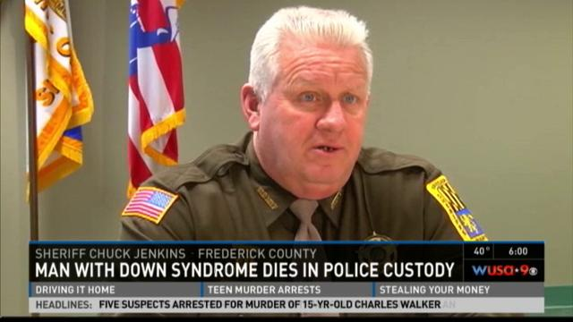
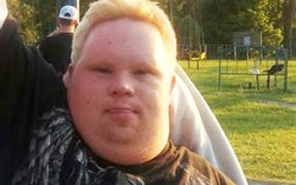
Tragedy in a movie theater
Tragic consequences of poor judgment and poor patience indicative of poor understanding
Evidence of lack of adequate training

Slide 24
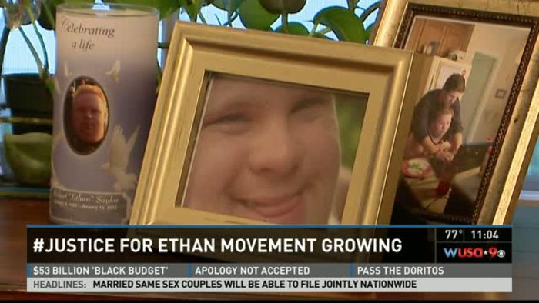
Outrage spurs grassroots action
Ethan Saylor Work Group formed March 2013
Partnership among Saylor family, disability advocates in DC and MD and organizational/agency representatives
Demand for mandatory, comprehensive cross-disability training inclusive of self-advocates in meaningful roles.

Slide 25
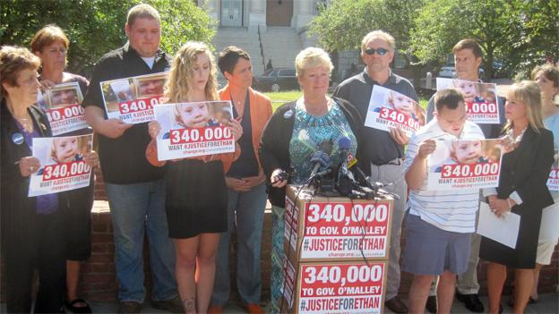
Positive tactics to force change
Traditional media
Local newspapers, television
Social media
Facebook, Twitter #JUSTICE FOR ETHAN
Change.org petition
379,000 signatures
Engage high profile spokespeople
Legislators, national organizations

Slide 26
Simultaneous tracks of justice and advocacy lead to results
Governor’s Commission for Effective Inclusion of Individuals with Intellectual and Developmental Disabilities
Reports issued December 2014 and December 2015
Department of Justice investigation
Grand jury investigation followed by civil suit
Regulatory action
Legislative action

Slide 27
Regulatory track
Important to reach out to state law enforcement/first responder leaders
Identify key police training commission key players in state
Gather information about status quo training programs
Create grassroots consensus & demand for better training
Self-advocates play key role in building relationships
Collaboration and buy-in from law enforcement leaders may lead to voluntary adoption of training mandates

Slide 28
Legislative track
Determine scope of the bill
Recognize political realities
Identify legislative sponsors
Look for connections to disability community
Bipartisan support
Grassroots support and advocacy
Cross-disability effort
Engage local, state and national self-advocacy leadership
Self-advocate participation in all meetings, hearings, testimony
Enlist help of law enforcement/first responder to attend meetings and testify in support

Slide 29
Maryland law: Ethan Saylor Alliance for Self-Advocates as Educators
Landmark Maryland bill establishes framework for preparing and supporting self-advocates to co-lead trainings
Alliance has been established as part of the state government in the Department of Disability
Central premise is “nothing about us, without us”
Self-advocates will be prepared, supported and compensated to participate as co-leaders in local law enforcement and other public entity trainings

Slide 30
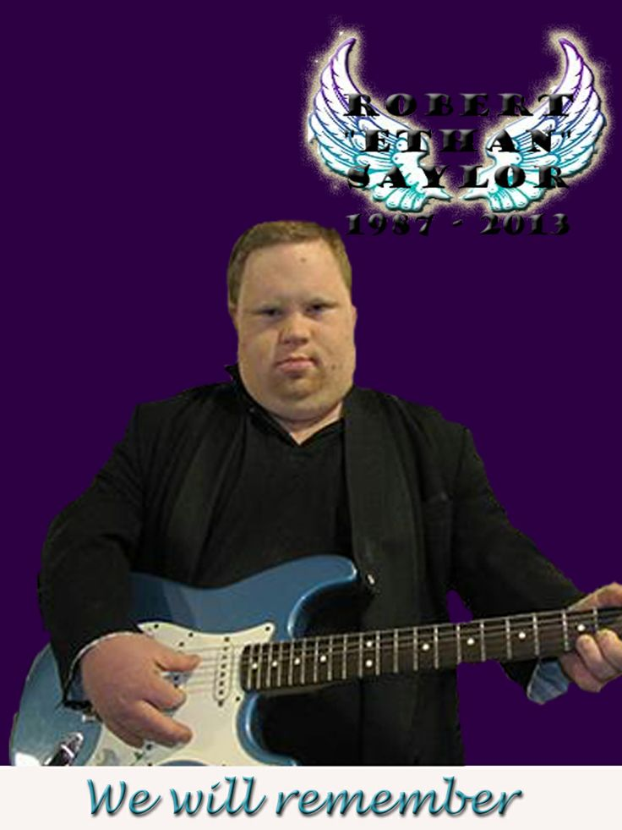
Continued advocacy for implementation
Saylor Alliance finally funded by Governor
Only funded first year, not five as requested
Varying levels of expertise of members
Scrutinize local training programs
Self-advocates must play key role
Suggest best practices
Demonstrate success, collect data
Expand concept to other states
National Down Syndrome Society toolkit
Advocacy at national level
Department of Justice forming workgroup to develop training program

Slide 31
More Information
For more information, please contact
Patti Saylor - saylor11@comcast.net
Heather Sachs - hsachs@ndss.org

Slide 32
Questions?
Register for the next webinar on June 23rd, on issues attorneys face in representing clients with I/DD – more info to come soon!
Sign up to receive email alerts, use I&R/TA service, and refer others
Our website: www.thearc.org/NCCJD
Contact us at:
NCCJDinfo@thearc.org

