Slide 1
Autism and the Internet: an Addendum to Sex Offenders with Intellectual and Developmental Disabilities(I/DD)
The Arc’s National Center on Criminal Justice and Disability™ (NCCJD)
Leigh Ann Davis, M.S.S.W., M.P.A., Program Manager
Kathryn J. Walker, J.D., M.P.H., Criminal Justice Fellow

Slide 2
Welcome!
First time using webex?
  You can communicate using the Chat Box and seek technical assistance if needed.
  You can type questions about the material presented in the Q&A section.
  Use this link for live captioning: http://streamtext.net/text.aspx?event=Arc
Today’s webinar will be recorded and archived on the NCCJD website. Please keep this in mind when sharing information and experiences during the webinar.

Slide 3
Introduction
Leigh Ann Davis, M.S.S.W., M.P.A., Program Manager
Kathryn Walker, J.D., M.P.H., Criminal Justice Fellow

Slide 4
Thank you to our presenters!
Dr. Alexander Westphal
Autism Spectrum Disorder and Sexual Misbehavior: A Theoretical Perspective
Dr. Laurie Sperry
Sexual Offending and ASD: Risks and Vulnerabilities
Dr. Rachel Loftin
Sexuality Education and ASD

Slide 5
Disability Basics:
  Understand: Know the challenges people with disabilities face
  Understand: Knowing one person with a disability means you know ONE PERSON with a disability
  Understand: This is a human rights issue just like race, gender, and religion

Slide 6
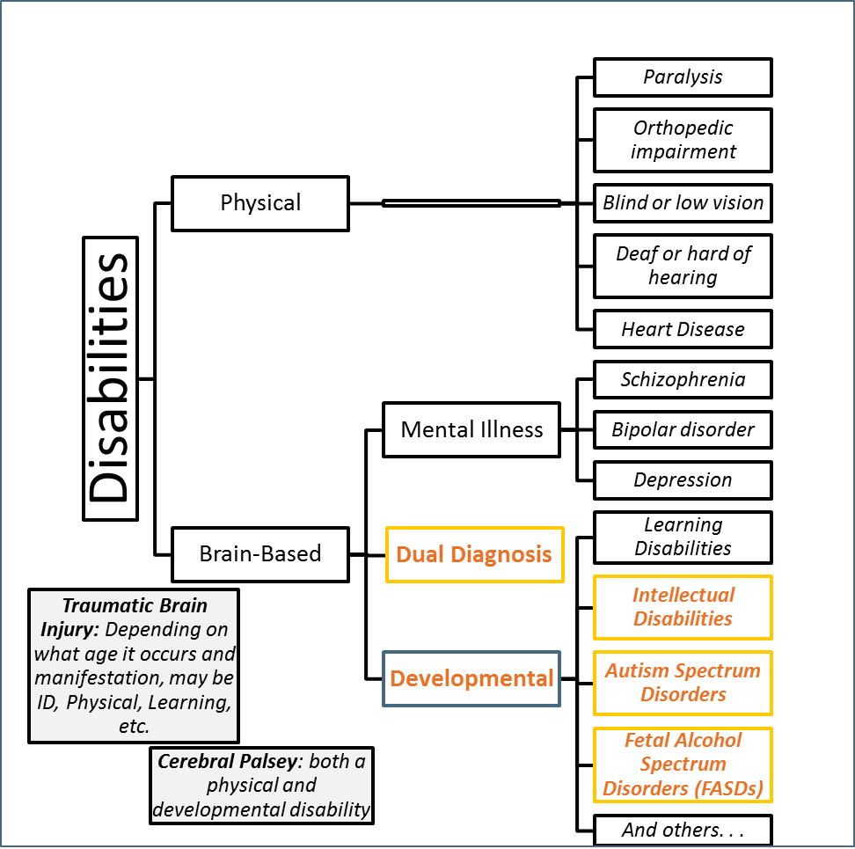
Notes:
This is not an exclusive list of disabilities but is a way to help visualize the wide array of experiences that "disability" can indicate. The words in italics are examples of some of the types of disabilities you may encounter. There are definite limitations to the chart, for example TBI and CP can fall under multiple categories.
EXE: Someone with a traumatic brain injury (TBI) may have physical issues, intellectual issues, or mental illness as a result of their injury.
EXE: Cerebral Palsy (CP) will have a physical disability component but may or may not be accompanied by intellectual disability.
While the diagnoses in the diagram are necessary in the legal system for many reasons, in exigent (or emergency) circumstances, it may be most efficient to examine functional needs of the person you are working with. Functional descriptions of disabilities describe the skills a person has or lacks and identifies what they enable the person to do. These functional descriptions allow professionals to identify the specific skills that a person needs to acquire to meet certain goals and the supports needed to gain those skills.

Slide 7
Points to Remember
These are hard issues to discuss, and are rarely as clear-cut as we would like
People with disabilities should take responsibility for their actions; likewise society should acknowledge true risk
You don’t have to reinvent the wheel around these issues—there are seasoned professionals doing great work.

Slide 8

Autism Spectrum Disorder and Sexual Misbehavior
A Theoretical Perspective
Alexander Westphal, MD, PhD.
Assistant Professor, Yale School of Medicine
(Division of Law and Psychiatry and Yale Child Study Center)
Notes:
It is not our intent to villify nor to give a free pass

Slide 9
DSM-V Diagnostic Criteria
Persistent deficits in social communication and social interaction across multiple contexts
Notes:
I going to mention briefly aspects of the current DSM dx criteria of autism that are relevant to the rest of our discussion.

Slide 10
αὐτός
Self, to the exclusion of others
i.e. alone, by oneself
Self not prompted or influenced by another,
i.e. of oneself, of one's own accord
Notes:
The Greek root of the word autism gives a little more information…. you can see it is at the root of words other than autism which have something to do with the meaning, including autonomous and automatic,

Slide 11
DSM-V Diagnostic Criteria
Restricted, repetitive patterns of behavior, interests, or activities.
Notes:
Next criteria
One aspect of this can be Insistence on sameness, inflexible adherence to routines, or ritualized patterns or verbal nonverbal behavior.
Another aspect of this is Highly restricted, fixated interests that are abnormal in intensity or focus (e.g, strong attachment to or preoccupation with unusual objects, excessively circumscribed or perseverative interest.

Slide 12
DSM-V Diagnostic Criteria
Restricted, repetitive patterns of behavior, interests, or activities.
Notes:
And another aspect, Hyper- or hyporeactivity to sensory input or unusual interests in sensory aspects of the environment
Each of these aspects can lead to problematic sexual behaviors. I just saw an interesting case presentation at the American APL meeting that argued that a man with ASDs focus on soiled diapers, something which I have also seen, was largely rooted in sensory aspects.

Slide 13
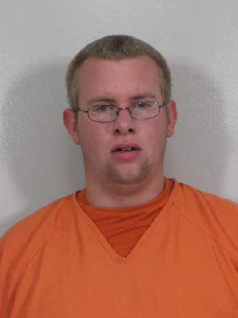
Notes:
I wanted to talk about a particular case, the case of Jacob Fisher, because it captures themes I want to focus on through the rest of the talk,. Jacob Fisher, is a 20 yr old with an ASD, who was accused of entering the unlocked house of a neighbor and stealing some underwear. He was sentenced to serve between 20 and 60 months in prison by Nebraska judge Mary Gilbride despite the fact that he had no previous convictions. The prosecutor is quoted as asking for a sentence of this length, because in his words:

Slide 14
Nebraska v Fisher
The pre-sentence investigation revealed that the defendant has a lot of issues which, if they go untreated, could put the public at risk. We asked for jail time in hopes that the defendant can get treatment while incarcerated.
Scott Tinglehoff, Prosecution
Notes:
READ SLIDE. Even if we are to grant noble intentions to Mr Tinglehoff, to grant that what he really cares about is treatment, the words still speak to a fundamental misunderstanding about the nature of autism, and how it can be treated.

Slide 15
Nebraska v Fisher
Because of his autism, there are psychological issues that come into play, and I would question whether prison would afford Jacob opportunities for treatment or rehabilitation. I think, however, it is extremely likely that he will be victimized in prison.
Thomas Klein, Defense
Notes:
This point was made by Mr. Fisher’s defense attorney, Tom Klein, who said: READ SLIDE.

Slide 16
Nebraska v Fisher
He just walked in because the door was unlocked. Nothing of value was taken, and he didn't do any damage… He has no way of keeping himself safe in prison. When I talked with him on the video phone after court, he was scared. He was just so scared.
Barbara Fisher, Mom
Notes:
This point was also made by Mr. Fisher’s mother, who said: READ SLIDE.

Slide 17
Nebraska v Fisher
On February 3rd 2012 Jacob Fisher suffered a broken cheekbone and a fractured eye socket from an assault by other inmates.
Notes:
Read Slide.

Slide 18
ASD
Victim
Perpetrator
Notes:
Considering the case of jacb fisher, he could both be considered a perpetrator, in that he entered a house and stole underwear. He is also clearly a victim, given what happened to him in jail..

Slide 19
Perpetrator
Counterfeit
Criminal
Notes:
For the purposes of this discussion I want to divide things into two categories, Legitimate perpetration, and counterfeit perpetration. In Fishers case, although he did steal underwear, and that might have scary sexualized, connotations to some people, it might reflect something much less scary, e.g., an area of focused interest, or compulsive behavior, which had absolutely no implications for his risk of committing harm to others. I think that is an important point, that behaviors which in a typical person might be indicators of something alarming, might in someone with autism might come from an entirely different source. I’ll spend a significant portion of the rest of this talk trying to make this argument and clarify it from a variety of angles.

Slide 20
⬇Theory of Mind
⬇ability to see how one’s behavior may appear to others.
Counterfeit Deviance
Notes:
Im going to make the argument that counterfeit deviance is integrally related to the concept of theory of mind, deficits of which are fundamanetal to ASD.

Slide 21
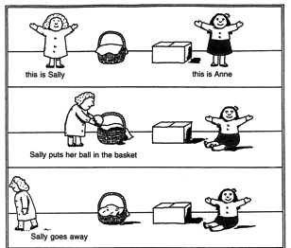
Notes:
What is theory of mind?

Slide 22
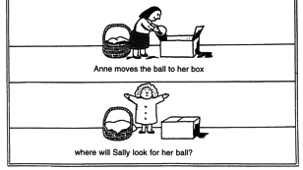

Slide 23

Notes:
I want to talk about gateway phenomena…. What are gates? Gates are the public face of something that is clearly intended to be kept private. The term gateway is part of the standard lingo in discussions about substances. But I also think that the concept is equally well applied to things you can encounter on the internet…. In fact, as you will see in a minute, I think that there are gateway factors which predate the internet….

Slide 24
Gateway
Neoteny
Mainstream Sexualization of minors
Naturism videos
Legal pornography w/ juvenile themes
Notes:
Here are some things that I think are gateways. I am going to talk about the first two only because of time constraints but I would also appreciate any thoughts on other gateway phenomena…. My email will be at the end of this talk. Please do send me an email if you think of others.

Slide 25
ne·ot·e·ny (nēˈät(ə)nē/)
- the retention of juvenile features in the adult animal.
Notes:
The first thing I wanted to talk about is the use of sexualized neoteny. Neoteny is the retention of juvenile features in the adult animal.

Slide 26
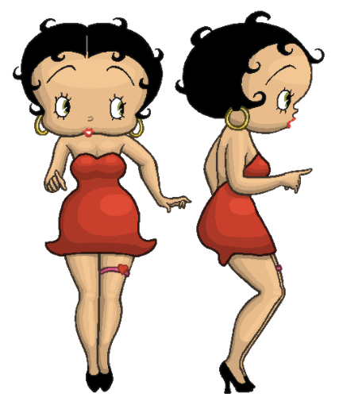
Notes:
A great example of this is Betty Boop…blah blah……The cartoon of Betty Boop illustrates some human features which are sometimes labeled as neotenous, such as a large head, short arms and legs relative to total height, and clumsy, child–like movements." — Barry Bogin[11] Barry Bogin (6 May 1999). Patterns of Human Growth. Cambridge University Press.

Slide 27

R18 / Hentai
Notes:
In a more direct example of this phenomenon, I wanted to mention graphic cartoons, of which this is a pg13 version. Much of the effect of these depends on neoteny. This is a sexualzed adult body with a childs face. It makes complete sense to me that viewing material from this genre is a step towards viewing images of the sexual abuse of children. So its an example of wgat I mean when I talk about gateway images….

Slide 28
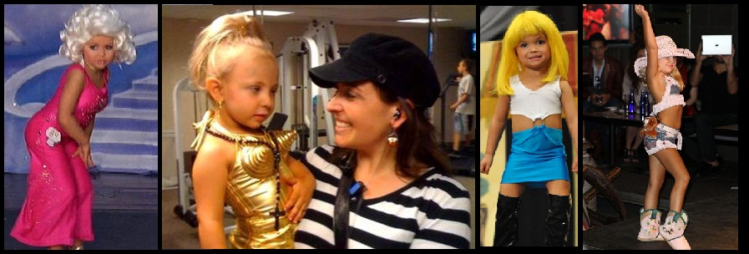
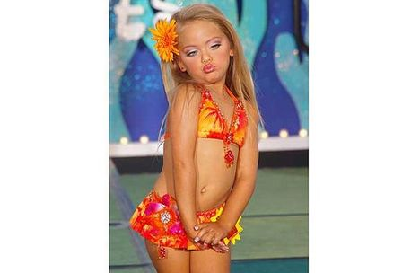
Sexualization of Minors

Slide 29
COPINE
(Combating Paedophile Information Networks in Europe)
Indicative: non-erotic / non-sexualized pictures showing children in underwear, swim costumes from commercial sources, family albums
Nudist: Pictures of naked or semi-naked children in appropriate nudist settings and from legitimate sources
Erotica: Surreptitiously taken photos of children in ‘safe environments’ showing either underwear of varying degrees of nakedness
Posing: Deliberately posed pictures of un/clothed children (where the amount, context and organization suggest sexual interest)
Erotic Posing: un/clothed children in sexualized or provocative poses
Explicit Erotic Posing: un/clothed, emphasizing genital areas.
Explicit Sexual Activity: sexual activity not involving an adult
Assault: Sexual assault involving an adult
Gross Assault: Grossly obscene (#8)
Sadistic/Beastiality
Notes:
So I want to do a poll and see where people think this video lies…. The overarching issue, with all of these gatgeway phenomena is the ability of the person to discern where the line is…and this goes back to counterfeit deviance and theory of mind. If I don’t get the way that this will appear to people, whats to stop me…. . This can be subtle stuff, remember the COPINE grading scale has 10 gradations, some legal. In some way this ability to discern is related to ability to assess realtiy and the appropraiteness of a behavior your are seeing modeled or endorsed on a screen. This has implications well beyond sexyal realm

Slide 30
Summary
Counterfeit Deviance
Gateway Phenomena

Slide 31
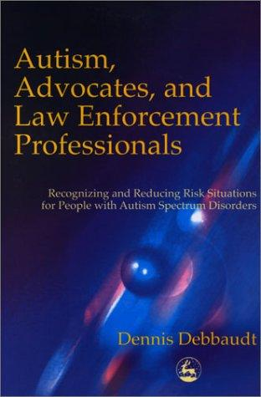
http://www.autismriskmanagement.com/
Notes:
In terms of some great advice about things like this, here is a recommended book and below, a website. The book, Autism, Advocates, and Law Enforcement Professionals by Dennis Debbaudt is an excellent resource . It is packed with practical advice. I’d strongly recommend visiting Dennis Debbaudt’s website also.

Slide 32
Resources
Sexuality and Developmental Disabilities
http://www.diverse-city.com/
Asperger’s, Law, and Child Pornography
http://www.harringtonmahoney.com/publications

Slide 33
Thank You
Alexander Westphal, MD, PhD.
Assistant Professor, Division of Law and Psychiatry, Department of Psychiatry, Yale School of Medicine
Assistant Professor, Yale Child Study Center
Home base: Division of Law and Psychiatry,
34 Park St, CMHC, New Haven, CT 06519
Alexander.Westphal@Yale.edu
Notes:
The differences that define autism have parallels with the differences of culture. when someone comes from another culture in the traditional sense, it would be no surprise that they might need a translator. Working with someone with autism is analogous – communication is different on many levels, Furthemroe, what’s salient to the perspn with autism in the world around them may be completely different, as would be reasonable for someone from a different culture.

Slide 34
Sexual Offending and ASD:
Risks and Vulnerabilities
Laurie Sperry, PhD., BCBA-D, MSc
Forensic Psychology, Criminology,
Associate Professor

Slide 35
Framing the Discussion of Sexual Offending and ASD
What characteristics of ASD might place people at risk of engaging in criminal-level sexual behavior?
Notes:
Review Lexy’s ideas
Consider the traits of a person with ASD as highlighted by Dr. Westphal,
ToM or Social comprehension deficit -difficulty understanding or appreciating the impact of their behavior on others
In the special case of child pornography, which we will be talking about today, there would be the lack of perspective taking on the harm done to the children exploited in these images.
Moreover, impairments in executive functioning might inhibit the person’s ability to think through the consequences of their behavior. The What ifs? (Attwood, 2014).

Slide 36
Developmental Disparities
Adolescence as “The Second Crisis”- Individuals with ASD may have sexual feelings that are out-of-sync with their level of social development and awareness
Social and sexual skill sets are likely to become more disparate with chronological age and appearance
Other people, however, will base expectations on chronological age, NOT their developmental age (American Academy of Pediatrics, 1996; Koller, 2000; Volkmar & Wiesner, 2004)
Notes:
individuals who have an intellectual disability have lower levels of sexual knowledge and experience in all areas except menstruation and body part identification when compared to a typical student population. In other words, they may understand some of the mechanics as they relate to sex, but they may be missing the social piece that would allow them the ACCESS to the mechanics. (McCabe & Cummins, 1996; Szollo & McCabe, 1995)

Slide 37

Q: What is this man doing?
A: “[T]he hand is somewhere;
he chopped it off.” (Konstantareas & Lunsky, 1997, p. 411)
Notes:
In this study, researchers investigated the sociosexual knowledge, experiences and interests of people with ASD. They were shown a series of pictures like this one and asked what the people were doing in the picture. For me this picture in particular highlights how the cognitive differences including central coherence, ToM deficits and the literal nature of a person with ASD exacerbates the deficits in social/sexual understanding.

Slide 38

Internet
Legal Pornography > 20 Billion dollar a year global industry (Barrett, 2012)
The majority of viewers are male.
Places viewers at risk for:
31% increased risk of developing sexually deviant tendencies
22% increased risk of committing a sexual offense
31% increased risk of accepting rape myths
Notes:
If this figure represents the legal pornography industry one can only imagine what the illegal industry generates financially.
Pornography viewers who are neurotypical are at risk for these increases in maladaptive behaviors and thinking. It’s not clear how much greater the risk is for the viewer with ASD though given how people with ASD are visual learning strengths and they tend to gravitate towards online activities it’s reasonable to assume that at the very least these risks apply to them at similar or greater rates
Oversexualization of young girls. Take for example Party City costumes 16 career costumes for boys, 5 for girls of the 5 one was a sexy cop
FAQs from Kinsey
Saw these general population facts on the kinsey website and thought some might be interesting/useful for you. from http://www.kinseyinstitute.org/resources/FAQ.html#internet
Overuse, pornography, infidelity, and risky behaviors are among the most frequently treated Internet-related problems by mental health professionals. (Mitchell, 2005).
Over half of all spending on the Internet is estimated to be related to sex. (Yoder, 2005).
US porn revenues have been estimated to exceed the combined revenues of companies like ABC, CBS, and NBC. (Yoder, 2005).
In a survey of adolescent (10-17yrs) internet users found 42% had been exposed to internet pornography in the past year, with 66% of those exposures reported as unwanted. (Wolak, 2007).
Only boys ages 16-17 reported more wanted exposures than unwanted exposures to internet pornography. (Wolak, 2007).
In a national study, 14% of people reported having used a sexually explicit website ever (Buzzell, 2005).
In the same study, 25% of men reported visiting a pornographic site in the previous 30 days; 4% of women reported visiting pornographic sites in the same timeframe. (Buzzell, 2005).
Only 8% of men and women using the Internet for sexual reasons reported significant problems typically associated with compulsive disorders (Cooper, Scherer, Boies, Gordon, 1999).
In a study of Internet addiction of 396 "addicts", as defined by the Diagnostic and Statistical Manual of Mental Disorders IV, the average time spent on the Internet for nonacademic and nonprofessional purposes was 38 hours per week (Cooper, Scherer, Boies, Gordon, 1999).
Males have been found to make up two thirds of users of sexually explicit Internet sites and account for 77% of on-line time (Cooper, Scherer, Boies, Gordon, 1999).
51% of women reported they never download sexual material (Cooper, Scherer, Boies, Gordon, 1999).
The empirical evidence is equivocal regarding the cathartic value of pornography. The extant literature on the consumption of violent pornography depicting consenting adults as a prophylactic against future offending suggests a resounding ‘it depends.’
The internet renders pornography more available, breaking down external inhibitions related to access. In 2006 Americans spent 13.3 billion dollars on the sex industry (legal commercial sex industry figures). It’s unknown how much money was spent on the illegal side of the sex industry. Thirty-four percent of American men and 16% of American women regularly view pornography. 61% of Americans think pornography is morally wrong, 50% think it demeans women and 40% of Americans want to see it banned. Weitzer highlights the paradox presented by these statistics; the sex is a significant money making industry with a large customer base and high rates of employment, but a majority of Americans report believing that it is deviant and requires more controls.
A meta-analysis completed by Allen, Alessio and Brezgel (1995) (N=2040) found an association between aggression and pornography. The type of pornography was a moderating variable; participants who viewed nudity had lower rates of future aggression while participants who viewed both non-violent and violent sexual content had higher rates of future aggression. Malamuth, Addison and Koth (2000) completed a study (N=2,972) of offenders and non-offenders. In the non-offenders group there was a positive association between the frequency of pornography consumption and coercive sex. Frequent consumption was also found to be predictive of sexual aggressiveness. In the offender group, the frequency of consumption was similar to rates in the non-offender group. In self-reports, known offenders acknowledged that they were influenced to offend following the consumption of pornography but interestingly, the type viewed was often consensual sex. The impact of viewing pornography is mitigated or exacerbated by static risk factors such as family environment, anger management and drug and alcohol use (Vega & Malamuth, 2007).

Slide 39
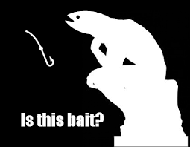
Vulnerabilities of Internet Users with ASD
Adolescents with ASD spend more time online than in any other leisure activity (Mazurek & Wenstrup, 2013)
In the absence of ASD specific sexuality education and information from peer confederates, adolescents with ASD often turn to the internet for information about sex.
FREE pornography websites comprise 70-80% of all adult material online (bait).
Notes:
1. adolescents with ASD spend an average of 4.4 hours a day online.
2. In the absence of appropriate sexuality education, and a peer group with whom they can vet information, the internet, and in particular pornography may
become the sole source of their sexual knowledge.
3. Not coincidentally A study by the Kaiser Family Foundation found that 70% of first time teen viewers of pornography accidentally stumbled upon it online. 93% of boys and 62 % of girls have been exposed to online pornography before the age of 18
15% of boys and 9% of girls have seen images of child exploitation online before the age of 18.
In his excellent paper on Asperger’s Syndrome and the Criminal Law, Attorney Mark Mahoney points out that often times the distinction between of age and under aged females is intentionally blurred. When we consider Dr. Westphal’s comments about the cultural sexualization of young girls by the popular media one can begin to appreciate how extremely difficult it is for the person with ASD to make the determination between what is legal and what carries severe criminal penalties

Slide 40
Video Modeling
Bandura- modeling has a profound impact on the development of children (1977).
Video modeling-Technique that involves demonstration of desired behaviors through video representation of the behavior.
As an Intervention-person with ASD watches the video demonstration of a behavior and then imitates the behavior of the model (Bellini & Akullian, 2007).
Pornography As a Video Model for Inappropriate Behavior- due to difficulties with Syllogistic Reasoning and belief persistence
Notes:
Bandura- The concept of modeling, or observational learning, as an intervention technique was introduced
40 years ago by Albert Bandura as part of his seminal work on social learning theory. Bandura demonstrated that children acquire a vast array of skills by observing other people perform the skills, observers will imitate behaviors with or without the presence of reinforcement, and will perform the
behavior in settings other than the setting where it was originally observed.
Video Modeling is a strategy often used in the field of ASD to promote skill acquisition. Skills learned through video modeling are maintained over time and transferred across people and settings (Bellini & Akullian, 2007).
It’s possible that given the strong visual learning skills of people with ASD and the success of video modeling as a strategy to teach PRO social behaviors that Pornography/Images of Child Exploitation may be serving as a video model for sexual offending behavior.
This may be partly explained by difficulties in syllogistic reasoning. This is a form of reasoning in which a conclusion is drawn (whether validly or not) from using rules of logic. Inferences drawn from empirically false content is heavily dependent on background knowledge- We’ve already established that people with ASD have a paucity of background knowledge in terms of social and sexual functioning, compounded by limited numbers of friend with whom they could test out this information. This might make the person with ASD particularly susceptible to the kinds of sexual hyperbole, misogynistic behaviors and rape myths that are perpetuated by pornography.
A neurotypical adolescent may be able to alter their beliefs when presented with evidence to the contrary the adolescent with ASD will persist in their beliefs and this belief persistence is more heavily influenced by their knowledge about the world and social stereotypes that they’ve formed. Therefore they may be more likely to take the information they see at face value and attempt to emulate it despite evidence/information to the contrary.
Why might fantasy engagement be related to ToM? The ability to imagine a
situation that differs from one’s present reality underlies both engagement in
fantasy and an understanding of others’ minds, in particular, false belief (Harris,
1994). When engaging in fantasy, a child must imagine that his or her imaginary
friend is sitting at the table or that the people in a television show can perform
magic spells. To understand false belief, children must imagine that the world
could be different than it is and that this different situation is what another
person believes to be true about the world. Fantasy, as one type of pretend
play, might give children practice in such imagining (Moses & Chandler, 1992;
Taylor & Carlson, 1997).
Engagement in fantastical worlds specifically might be related to ToM,
beyond an association between ToM and pretending about realistic scenarios.
When engaging in fantasy, children must imagine impossible entities and events.
According to Vygotsky (1967), the further away one gets from reality, the more
psychologically challenging it is to create and manipulate the fantasy world.
Perhaps engaging in fantasy worlds specifically builds up children’s ability to
create alternative realities, a skill that later serves them in their understanding of
others’ minds (Saltz, Dixon, & Johnson, 1977).

Slide 41
Potential Pathways to Offending for People with ASD
General Population
ASD
Process models and pathways to pedophilia (Beech, 2010; Finkelhor, 1984)
Attractors-items used to attract children
Interactors-items, activities used to lower inhibitions and heighten arousal in children
Naiveté
Lack of Sexual Awareness
Lack of understanding of Inappropriateness
Sexual Offending
Notes:
Process models serve to explain the course of offending and the antecedents, behaviors and consequences related to the offending behavior (Beech, 2010). The Finkelhor model (1984) identifies the pathways to child sexual abuse as progressing through four stages.
Stage one considers the genesis of the event. Is the perpetrator a pedophile who has a specific sexual attraction to children? Is there an emotional congruence present, meaning the perpetrator is emotionally and cognitively identifying with childhood?
Stage two involves developing mechanisms to override inhibitions the individual holds relative to discovery. The offender may use drugs or alcohol to reduce internal reservations about their actions or may develop cognitive distortions which allow them to interpret information in a way that legitimizes their behavior.
The third stage involves surmounting external obstacles to offending with the goal of achieving contact with a potential child victim. Savvy predators may seek out positions of trust while managing their image and granting them access to children.
In the fourth stage, a predator attempts to conquer the child’s noncompliance by breaking down adult/child barriers and escalating the type and amount of sexual activity often through the use of force or threats against the child or their family
Attractors- ie video games, electronics,
Interactors- alcohol, pornography
For the person with ASD the pathways are different.
Naiveté : Duped I dare you to: to the more serious crime of : 19 year old with DD , estimated IQ of 70 who participated in a gang rape of an intoxicated and unconscious minor because his younger brother convinced him it was okay because she wasn’t saying no.
Lack of Sexual awareness- Masturbating in public, urinating in public, exposing oneself in public. Case of a babysitter with ASD who bathed two young children because he thought that’s what babysitters did. Children reported it, mother pressed charges, man spent 10 years in prison.
Lack of understanding of inappropriateness of sexual relationship with a minor-
Examples from last webinar . Case of 20 year old man with ASD who followed what he understood the rules to be: You have to know the person, you have to like the person, you have to get the person’s permission to have sex. He did all that- with a 10 year old neighbor.
Case of a man who was having sex with a minor. He disclosed his relationship with the boy to police when the victim stole his stereo equipment.
Sexual Preoccupations this relates back to the idea that. As children with ASD grow older, their social and sexual skill sets are likely to become more disparate with their chronological age and appearance. They may still more closely identify with themselves as a child with no idea how to be physically intimate with an adult (Attwood, 2014).

Slide 42
Differences in Offending
Quote from Sexual Offender WITHOUT Autism
Quote from Sexual Offender WITH Autism
“Show me a kid who doesn’t know about sex…….
And I’ll show you my next victim.
I learned the rules….
By breaking them

Slide 43
Laurie Sperry
lasperry@hotmail.com

Slide 44
References
American Academy of Pediatrics Committee on Children with Disabilities (1996). Sexuality education of children and adolescents with developmental disabilities. Pediatrics, 97(2), 275-278.
Bandura, A. (1977). Social learning theory.
Beech, A.R. (2010). Sexual offenders. In J.M.Brown & E.A. Campbell (Eds.) The Cambridge Handbook of Forensic Psychology. New York: New York: Cambridge University Press. pp 102-110
Bellini, S., & Akullian, J. (2007). A meta-analysis of video modeling and video self-modeling interventions for children and adolescents with autism spectrum disorders. Exceptional children, 73(3), 264-287.
Finkelhor, D. (1984). Child sexual abuse: New theory and research. New York: Free Press.
Koller, R. (2000). Sexuality and adolescents with autism. Sexuality and Disability, 18(2), 125-135.
Konstantareas, M. & Lunsky, Y. (1997). Sociosexual knowledge, experience, attitudes, and interests of individuals with autistic disorder and developmental delay. Journal of Autism and Developmental Disorders, 27(4), 397-413
Mazurek, M.O., & Wenstrup, C. (2013). Television, video game and social media use among children with ASD and typically developing siblings. Journal of Autism and Developmental Disorders, 43(6), 1258-1271.
Volkmar, F. & Wiesner, L. (2004). Healthcare For Children on the Autism Spectrum: A Guide to Medical, Nutritional, and Behavioral Issues. Bethesda, MD: Woodbine House

Slide 45
Sexuality Education & ASD
Rachel Loftin, PhD
Clinical Director, AARTS Center

Slide 46
Overview
Rationale and need
  Brief sexuality in ASD versus neurotypicals
  Core features of ASD
  Associated features of ASD
Approach
Teaching

Slide 47
Risk
Victimization is primary risk
Failure to teach and deficits inherent in ASD can lead to risk of inadvertent criminal sexual behavior
  Stalking
  Illegal images
  Aggression

Slide 48
Sexual Behavior- Any?
Estimated 10% of adults with ASD have had sexual relationship(s)
  89 - 92% of general sample has by early 20s (NSSHB, 2010)
Asexuality may be more common in ASD but not clear
  General population estimates
    Exists in non-human animals
    5-10% (Poston & Baumle, 2010)
  5% to 33% in ASD may overestimate
  Most people with ASD desire relationships (Koegel et al, 2014)
Notes:
Kinsey FAQs (a little older than above data)
3% of men have had zero sexual partners since the age of 18, 20% have had 1 partner, 21% have had 2-4 partners, 23% have had 5-10 partners, 16% have had 11-20 partners, and 17% have had 21 or more partners (Laumann, Gagnon, Michael, Michaels, 1994).
3% of women have had zero sexual partners since the age of 18, 31% have had 1 partner, 36% have had 2-4 partners, 20% have had 5-10 partners, 6% have had 11-20 partners, and 3% have had 21 or more partners (Laumann, Gagnon, Michael, Michaels, 1994).

Slide 49
Sexual Behavior: Same Sex
Some studies find high rates of bisexuality and homosexuality in ASD
General population
  4 – 6% males report same-sex contact
  4 – 12% females report same-sex sexual contact
  (Chandra, Mosher, Copen, and Sionean 2011)

Slide 50
Sexual Identity
General Population
Homosexuality 2% to 8% of males, 1% to 7% of females.
Bisexuality 1% and 3% of males, 2% to 5% of females.
(NSSHB, 2010; Chandra, Mosher, Copen, and Sionean 2011)
Identity < Behavior (NSSHB, 2010)

Slide 51
Sexual Identity
Unclear #s
Seem to be higher rates of identified bisexuality and homosexuality in ASD
If there is a difference, why?
  Selectivity theory
  Autoeroticism may explain some perceived asexuality
  Lack of “filter” or closeting

Slide 52
How to Teach
Explicit
Task analytic approach
Incremental
Examples and nonexamples from real life
Visual supports
Return to topics repeatedly
Check for comprehension

Slide 53
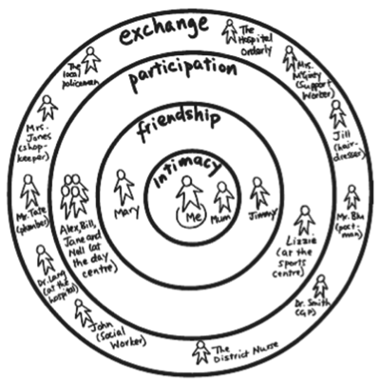

Slide 55
When Teaching consider:
Executive function
Learning style
Anxiety

Slide 56
Executive Processes
Planning
Abstract Problem Solving
Multi-tasking
Cognitive flexibility
Visual working memory
Inhibition
Interference control

Slide 57
Learning Style
Judgment and planning
Sequencing and organization
Attention – including shifting
Motivation
Comprehension

Slide 58
Learning Style
Process world in a narrow, intense, detailed manner
Unique learning profiles/disorders may exist
Generalization
Novel Problem Solving

Slide 59
Anxiety
Distress about sensitive information
Social anxiety
Interference with listening & learning
Insistence on sameness
Notes:
Social anxiety can make even talking about or imagining interactions painful

Slide 60
What to teach: General Content
Facts
Social Aspects
  What to do
  What not to do
  and…
  WHY (BIG IDEAS)

Slide 61
Sexuality Education
96% female and 97% male teens receive sex ed before 18 (CDC, 2010)
More students report learning about “how to say no” than about birth control
Quite common for students receiving special education to “skip” sex ed

Slide 62
What to Teach: Facts
Hygiene and Self-Care
  How-to
  Schedules
Terms for Anatomy
  Proper
  Slang
Terms for Acts
  Proper
  Slang

Slide 63
What to Teach: How-To’s
Masturbation
  Physical safety concerns
Mechanics of Partnered Sex Acts
  Homosexual and heterosexual
  Safer sex practices

Slide 64
What to Teach: Social Pieces
Personal boundaries
Public versus private behavior
Good touch versus bad touch
Levels of intimacy
Relationship building
Avoiding danger and abuse
Dating skills
Personal responsibilities and values
Social perception of sexual content

Slide 65
What to Teach: Social Pieces
Hygiene: the why
Terms: which to use with whom, settings
Acts: when, where appropriate, how, and with whom to initiate; partners’ experience
Masturbation: where

Slide 66


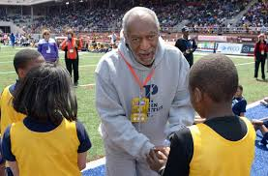
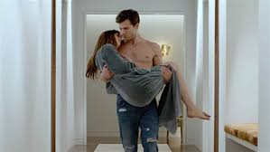
What to Teach: Consent
This is a tricky concept, even for typically developing people.
Notes:
Back to social anxiety- how to teach in a way that doesn’t impede sexuality forever?

Slide 67
Counteracting Media Influence
Explicit instruction
Rules
Appropriate models for relationships

Slide 68
EXAMPLE: Teaching about porn
(adapted from NYT)
Legality/ Illegality
One “shadowy and loveless corner”
Bodies respond differently than minds (women example)
Exploitation
Notes:
Assume that everything you do online can be seen by everyone you know
Talk about presenting this at AASECT

Slide 69
EXAMPLE: Teaching about porn
Social perception
How to discuss
“Kabuki theater”
Porn is fake
  Using as a model can be quite harmful
Body image
Acts

Slide 70
EXAMPLE:
What to teach about how to use porn
Location
Use of electronics
Browser Histories
Privacy
Search Terms
Pop ups
Clean up
Notes:
Daniel’s beautiful women of wrestling example

Slide 71
Rachel L. Loftin, PhD
Rachel_loftin@rush.edu

Slide 72
References
Dombert, B. et al (2015). How common is men’s self-reported sexual interest in prepubescent children? Journal of Sex Research,
Laumann, E., Gagnon, J.H., Michael, R.T., & Michaels, S. (1994). The Social Organization of Sexuality: Sexual Practices in the United States. Chicago: University of Chicago Press.
Leitenberg, H., & Henning, K. (1995). Sexual fantasy. Psychological bulletin, 117(3), 469-496.
Poston, D. & Baumle, A. (2010). Patterns of asexuality in the United States. Demographic Research, 23, 509 – 530.

Slide 73

Questions?
Download the paper Sex Offenders with Intellectual/Developmental Disabilities: A Call to Action for Criminal Justice Professionals at http://www.thearc.org/NCCJD/publications/white-paper-sex-offenders-with-intellectual-developmental-disabilities
Addendum to follow
Contact us at:
NCCJDinfo@thearc.org

